Slide 1
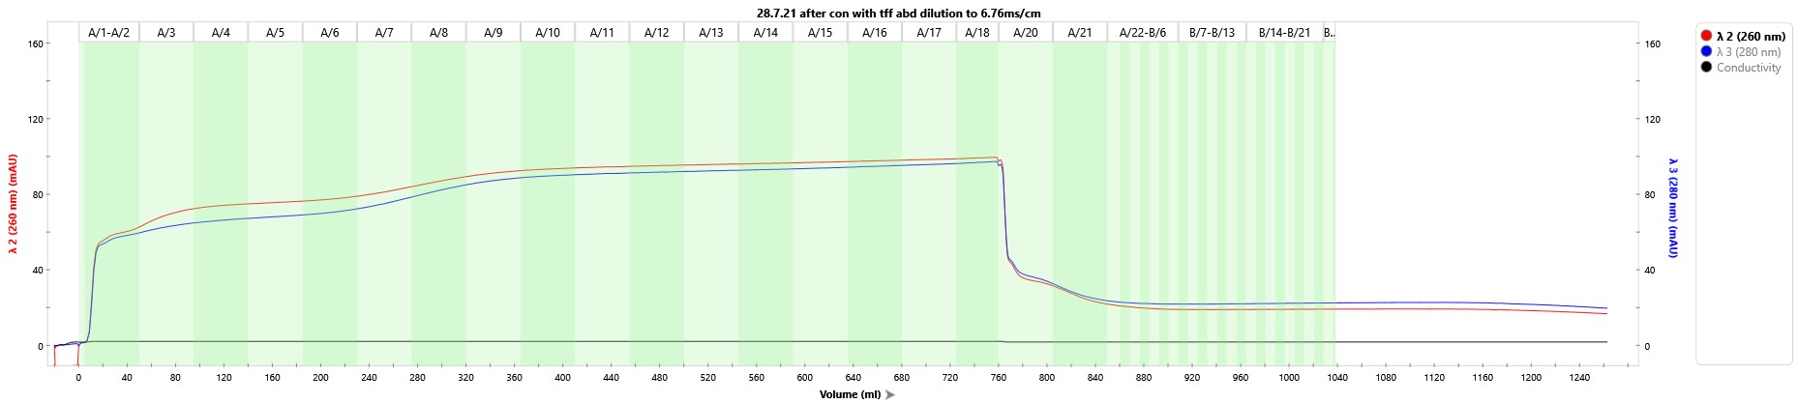
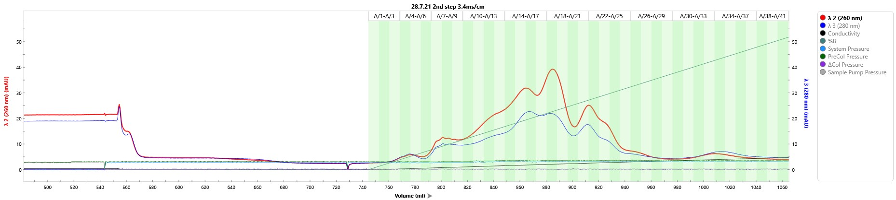
28.7.21 TFF trial : reg plasmids: hTERT-CMV, Bionoc ii , 5.5x10⁸ cells
Clarification: midikros 0.2 290cm^2
Concentration and Diafiltration: TangenX cassettes, 100um, pes, 0. 1m^2
28.7.21 Purification steps (Q-XL)
1st Run
2nd Run
Formulation: Ultracel 100KDa with Z buffer

Slide 2
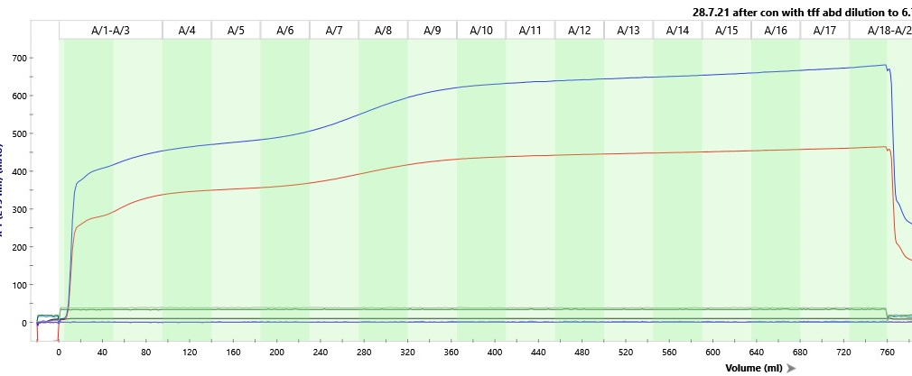
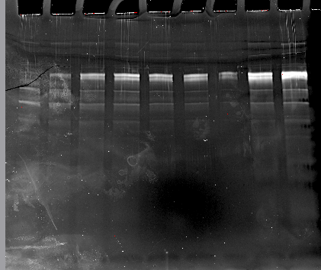
Low Recovery (Longer CIP)
Concentration followed by dilution- kept titer
5ml column- wide diameter: was not suitable for process
A2
A3
A4
A5
A6
A7
A8
A9
A10

Slide 3
20ml column- too large for sample: sample was lost during process

Slide 4
Reflects qPCR results
0.2um is too small
Full capsid’ yield is low

